Slide 1
Diversity
Mr. A. Wong
October 5, 2014

Slide 2
What Diversity Feels Like
Accept
Refuse
Harmony
Happiness
Friends
Hatred
Anger
Enemies

Slide 3
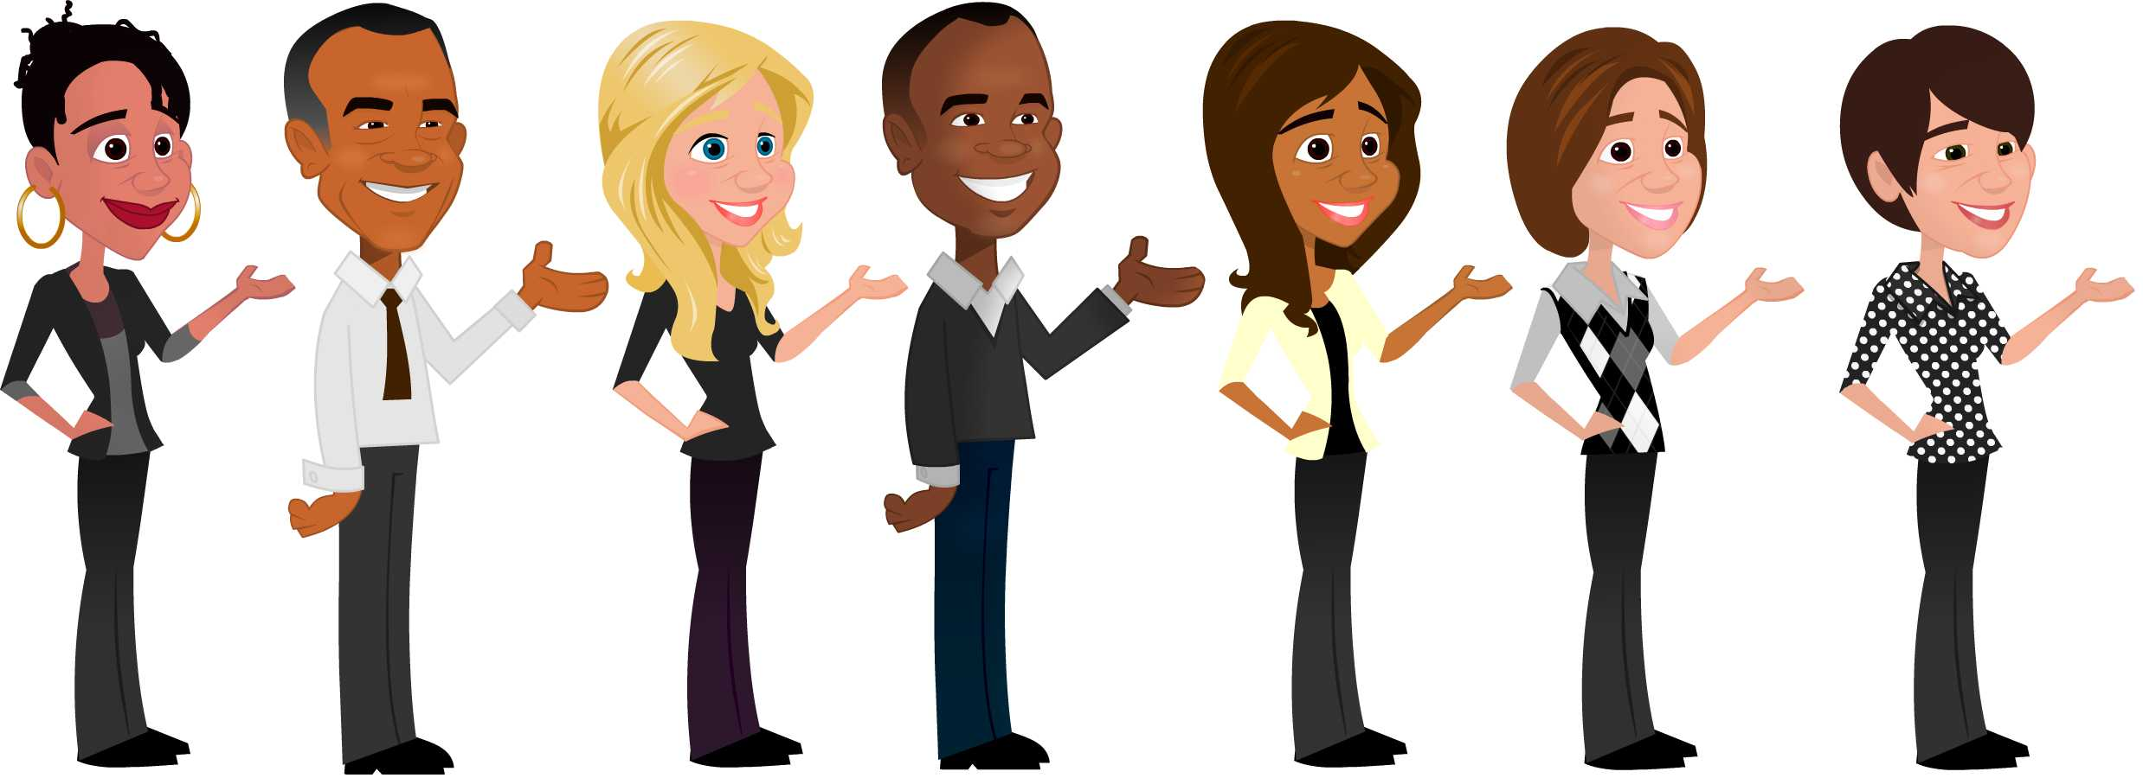
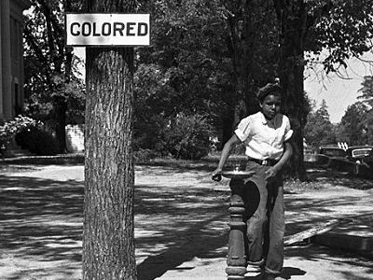
What Diversity Looks Like
Accept
Refuse

Slide 4
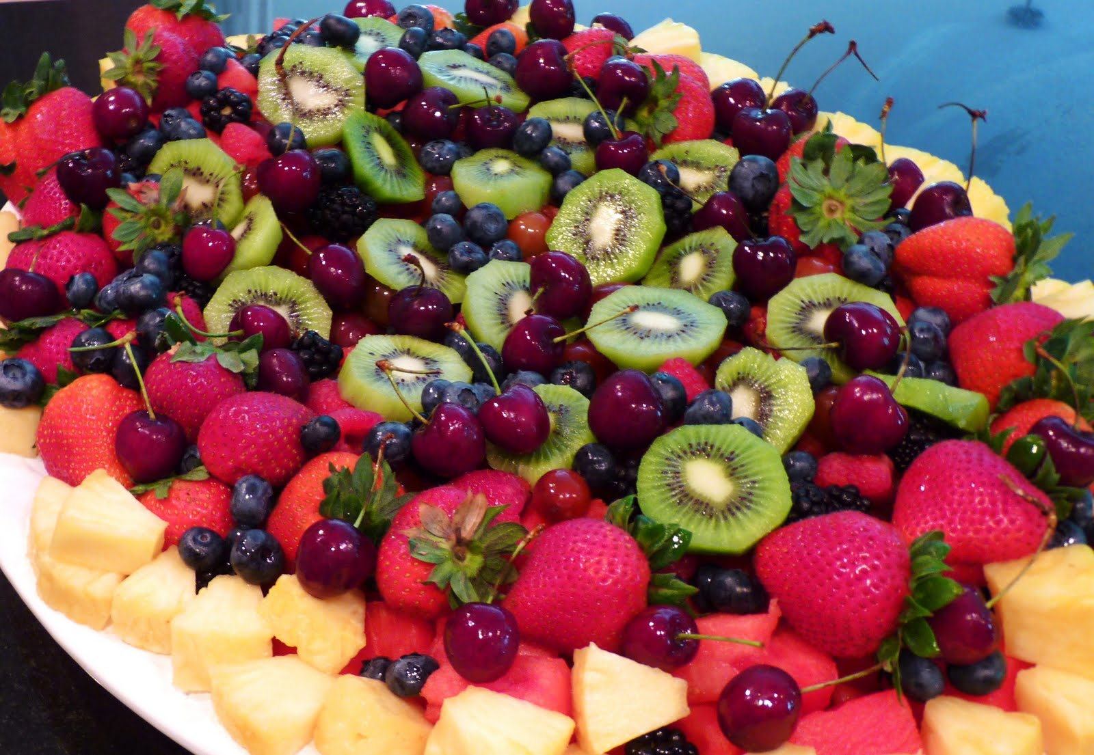


Diversity
More images including a metaphor

Slide 5
Diversity
You need to have at least 7 slides!
Also add some text explanations, not just images.

